Slide 1
Rosie’s BookList
Theme: My Favorites
EDLL 3100 Language & Learning 1
Section 1
December 2020

Slide 2
Table of Contents
Malala’s Magic Pencil
Love that Dog
Charlie and the Chocolate Factory
The Proudest Blue
Annie’s Plaid Shirt
How to make an Apple Pie and see the World
We are Water Protectors
A Computer Called Katherine
Nikki on the Line
C is for Canada

Slide 3
Table of Contents #2
11. Here We Are
12. Legacy and the Queen
13. The Giving Tree
14. Be Kind
15. Madeline
16. The Paper Bag Princess
17. The Berenstain Bears go to School
18. Green Eggs & Ham
19. The Lion King
20. The Outsiders

Slide 4
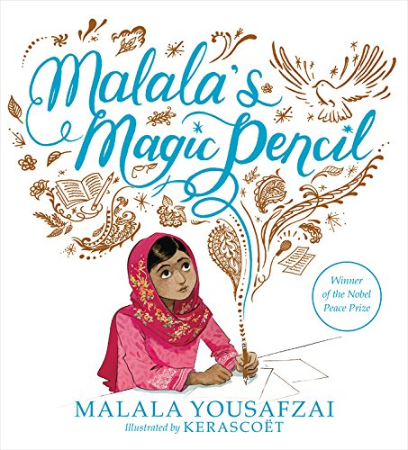
Malala’s Magic Pencil

Slide 5
Malala’s Magic Pencil (Autobiography)
Why I choose this book: This is a powerful and moving story about Malala, who at a young age spoke up about equality and eradicating war, poverty and hunger. This books shows how she was brave enough to speak out against the injustices in her country. It gives an insight about her journey and how she overcame hurdles to get to where she is now.
Grade: 4-7
Pedagogical goals:
Have the students create connections with the story
Big Idea (BC LA Curriculum)- Exploring stories and other texts help us understand ourselves and make connections to others and to the world.

Slide 6
Malala’s Magic Pencil (Autobiography)- CONT.
Strategies:
Pre-reading: Discuss the author, talk about who she is and why she is so important.
During reading: stop and reflect on important ideas, make connections when opportunity arises, question author purpose and point of view
Post-reading: Have students reflect and have them do an activity asking them if they had the opportunity “what would they use their magical pencil for?” (create a worksheet for them)

Slide 7
2. Love That Dog

Slide 8
Love that Dog (Poetry)
Why I choose this book: I like how the book captures the nervous feeling of a student writing poetry. It allows students to relate and discuss their feelings about poetry. It also provides different types of poetry within the book, this can be set up as a poetry unit.
Grade: 4-7
Pedagogical goals:
Have the students understand the meaning behind the text
Have them become comfortable with writing and reading poetry
Curricular Competencies (BC LA Curriculum)- Recognize and appreciate how different features, forms, and genres of texts reflect various purposes, audiences, and messages.

Slide 9
Love that Dog (Poetry)- CONT.
Strategies:
Pre-reading: explain the purpose of reading this book, have a discussion around poetry and how students feel about it
During-reading: Monitor the students understanding by asking questions during the read. After each poem have the students reflect and make connections to the text written.
Post-reading: clarify understanding about what was read, have students come up with a poem about their pet they own or their favorite animal.

Slide 10
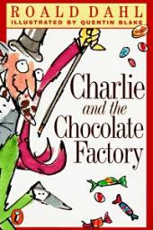
3. Charlie and the Chocolate Factory

Slide 11
Charlie and the Chocolate Factory (Fantasy Fun)
Why I choose this book: I have great memories of reading this book and then finally watching the movie. I love the message that is told, I feel like this is a great way to showcase how being humble and respectful can be rewarded in many ways.
Grade: 4-7
Pedagogical goals:
Have the students understand the meaning behind the text
Curricular Competencies (BC LA Curriculum)- Recognize and identify the role of personal, social, and cultural contexts, values, and perspectives in texts.
Curricular Competencies (BC LA Curriculum)- Construct meaningful personal connections between self, text, and world

Slide 12
Charlie and the Chocolate Factory (Fantasy Fun)- CONT.
Strategies:
Pre-reading: Asks students if they have watched or heard about the book. Then from there I would construct a purpose for reading this book ex: never let greed overcome your way of thinking.
During & Post Reading: This chapter book will be read over many weeks. Have the students do a creative project with the novel, maybe a art project.

Slide 13
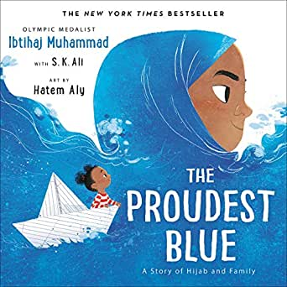
4. The Proudest Blue

Slide 14
The Proudest Blue (Family Diversity)
Why I choose this book: This story talks about cultural passages that some families go through when entering a certain age. It shines light to the issue many kids face much too often. I want my students to understand that wearing cultural clothing is nothing to be discouraged about but should be proud of.
Grade: 4-7
Pedagogical goals:
Have students understand the meaning behind family/ cultural diversity
Curricular Competencies (BC LA Curriculum)- Recognize and identify the role of personal, social, and cultural contexts, values, and perspectives in texts.
Curricular Competencies (BC LA Curriculum)- Recognize how language constructs personal, social, and cultural identity

Slide 15
The Proudest Blue (Family Diversity)- CONT.
Strategies:
Pre-reading: Go over the front cover and ask the students meaningful questions. Talk about the purpose of the read and the story behind it.
During-reading: Monitor the understanding of the text, infer meaning when can, make connections with text
Post-reading: clarify understanding of the novel, have students share experiences they have had with this issue, summarize/ final thoughts about book.

Slide 16
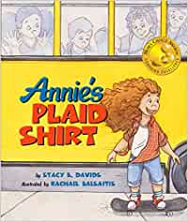
5. Annie’s Plaid Shirt

Slide 17
Annie’s Plaid Shirt (Exploring Identity)
Why I choose this book: This books tells a great story about a young girl who finds comfort in wearing her plaid shirt. I like how this book provides us with a such a simple but important message about identity. I know many of the students would relate to this book, because just a simple symbol like a shirt can create such an impactful message.
Grade: 4-5
Pedagogical goals:
Have students understand the meaning behind identity
Curricular Competencies (BC LA Curriculum)- Use personal experience and knowledge to connect to text and deepen understanding of self, community, and the world.

Slide 18
Annie’s Plaid Shirt (Exploring Identity)- CONT.
Strategies:
Pre-reading: Go over the purpose of the reading, go over the front cover ask students what they see, start discussion- provide questions.
During-reading: keep questioning the students about the images they are seeing, determine important ideas/ monitor understanding.
Post-reading: clarify understanding,extend understanding in critical and creative ways- maybe have journal time so they can talk about what they just read.

Slide 19
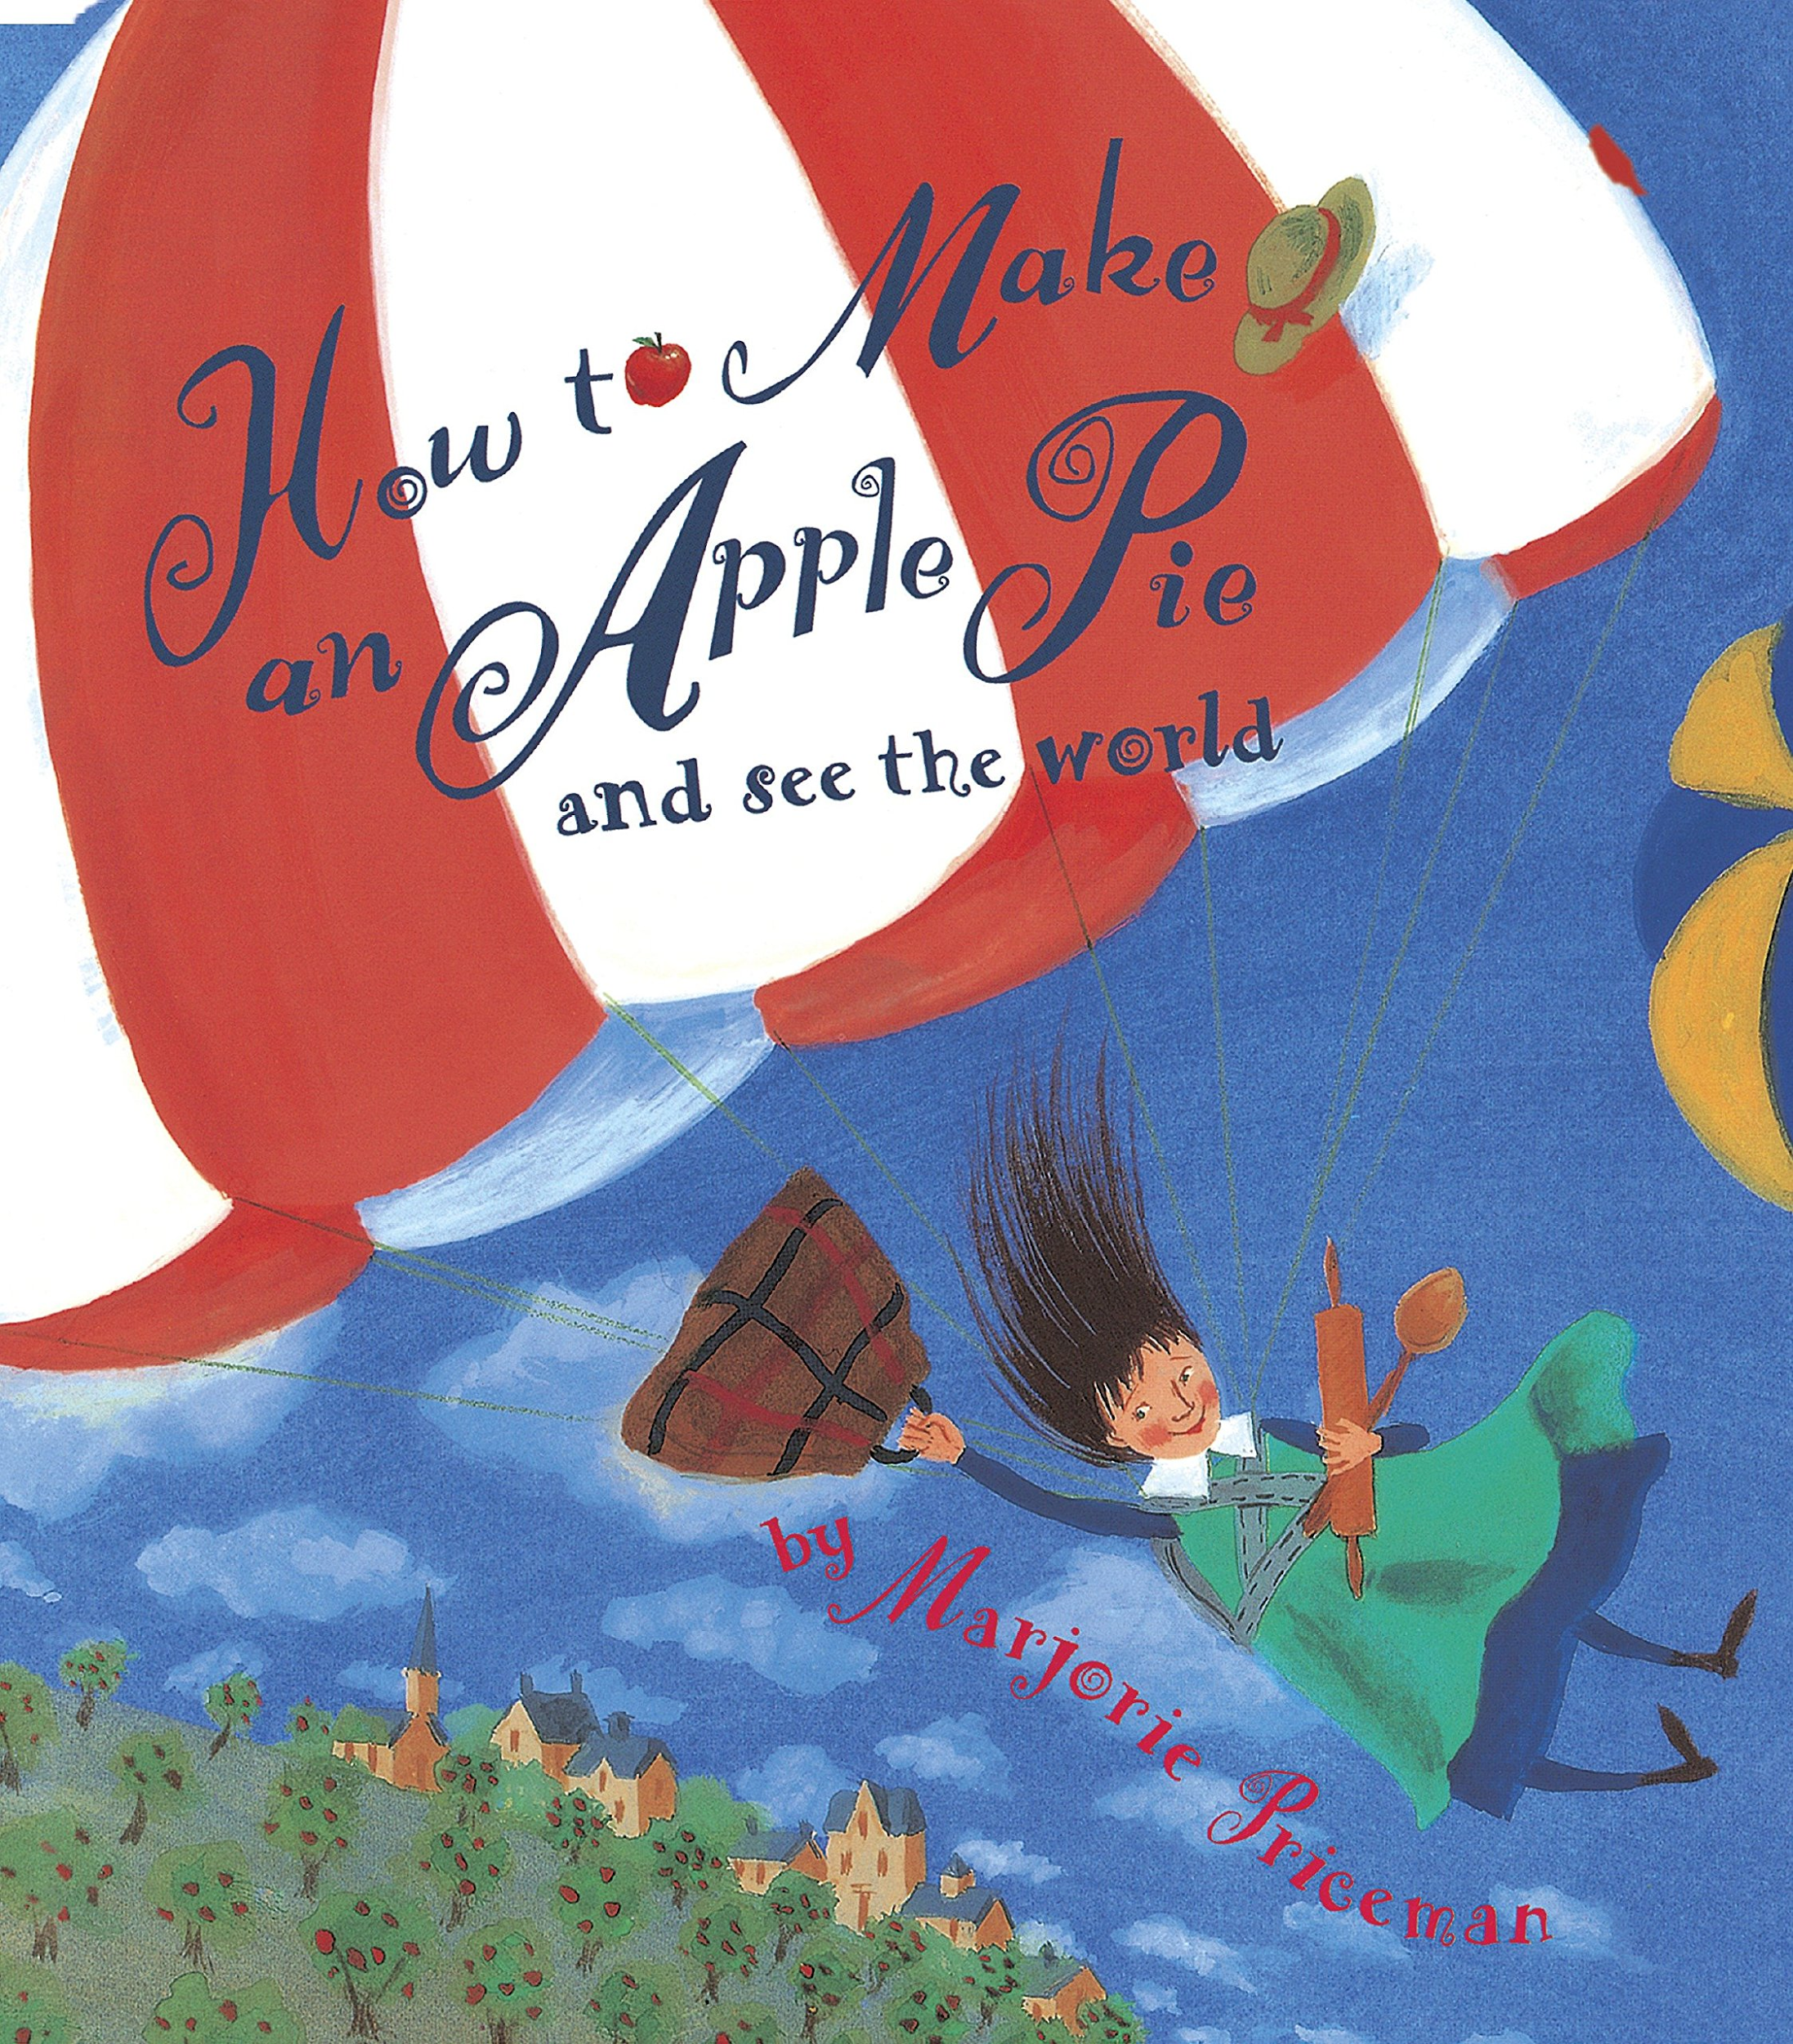
6. How to Make an Apple Pie and see the World

Slide 20
How to make an Apple Pie and see the world (Cultural Connections)
Why I choose this book: I like the concept of trying to teach students about every culture fairly, I feel like this book touches every country and really sends a message out about geography and diversity but also teaches cultural connections within each country she goes to as well.
Grade: 1-4
Pedagogical goals:
Curricular Competencies (BC LA Curriculum)- Demonstrate awareness of the role that story plays in personal, family, and community identity
Curricular Competencies (BC LA Curriculum)- Create stories and other texts to deepen awareness of self, family, and community

Slide 21
How to make an Apple Pie and see the world (Cultural Connections)- CONT.
Strategies:
Pre-reading: Go over the cover first- ask the students what they see, select a purpose for the read- let the students why we are reading the book today.
During-reading: stop at each page and talk about the visuals- make connections with culture, monitor understanding.
After-reading: Clarify understanding, have the students draw out places that they have been for a fun activity to do after the read.

Slide 22
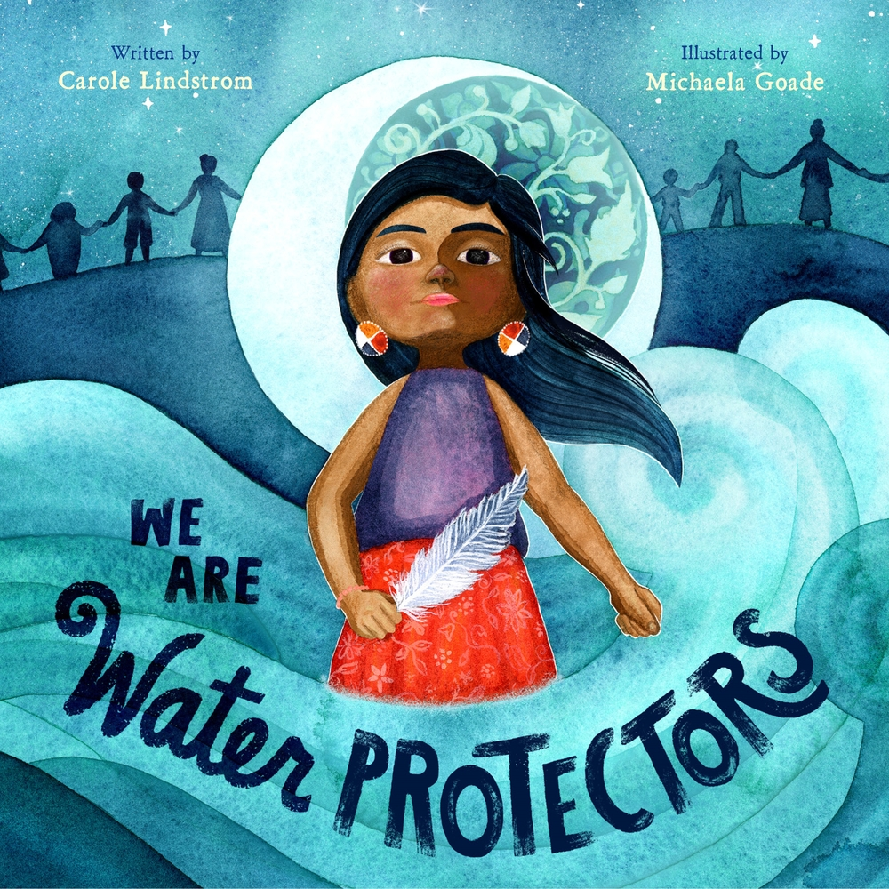
7. We are Water Protectors

Slide 23
We are Water Protectors (Indigenous Ways of Knowing)
Why I choose this book: This book sends such a great message about indigenous land and how the indigenous people will do anything to protect and and keep it safe. This story shows a young girl trying to rally the community to safeguard the Earth’s water from harm and corruption.
Grade: 3-5
Pedagogical goals:
Help students understand how important the indigenous culture is to Canada
Curricular Competencies (BC LA Curriculum)- Demonstrate awareness of the oral tradition in First Peoples cultures and the purposes of First Peoples texts.

Slide 24
We are Water Protectors (Indigenous Ways of Knowing)-CONT.
Strategies:
Pre-reading: Select a purpose for the read- give a summary about the Indigenous people, activate prior knowledge- start a quick discussion.
During-reading: determine important ideas during the read, infer meaning between text, use text features to help understanding
Post-reading: clarify understanding, analyze and evaluate ideas/information and perspectives. Have students write down what their favorite part was from the text and what would they like to know more of.

Slide 25
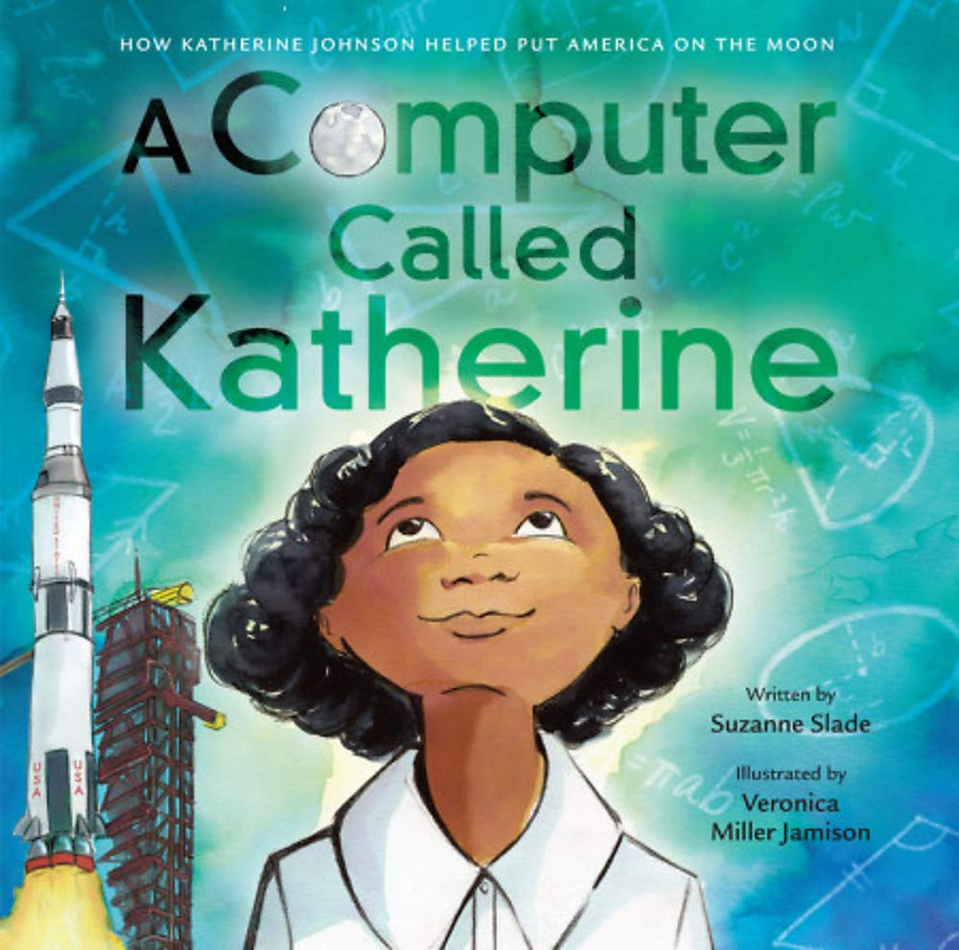
8. A Computer called Katherine

Slide 26
A Computer called Katherine (Wonders of Science)
Why I choose this book: This book talks about a young african american girl who goes beyond limits with her education and proves to her parents and classmates that she can work for NASA and one day visit the moon.Story enhances the ability to work hard for your dreams and shows us anything is possible if you are willing to learn.
Grade: 3-5
Pedagogical goals:
Curricular Competencies (BC LA Curriculum)- Construct meaningful personal connections between self, text and the world
Curricular Competencies (BC LA Curriculum)- Think critically, creatively, and reflectively to explore ideas within, between, and beyond texts

Slide 27
A Computer called Katherine (Wonders of Science)- CONT.
Strategies:
Pre-reading: Select the purpose of the read, Talk about the front cover and the visuals they see, question the cover and start up a discussion
During-reading: infer meaning, determine important ideas, talk about visualizes throughout the book
After-reading: clarify understanding, respond through talking, writing and drawing- have students draw out their dream job and have them write a few sentences/paragraph why they choice it.

Slide 28
9. Nikki on the Line

Slide 29
Nikki on the Line (Life Lessons/Transformation Stories)
Why I choose this book: This books talks about a young girl overcoming obstacles to become a basketball player. Throughout the book it shows the struggles she goes through in order to achieve her dreams. School, parents, boyfriends and friends are just some of the obstacles she has to go through.
Grade: 6-7
Pedagogical goals:
Curricular Competencies (BC LA Curriculum)- Recognize and identify the role of personal, social, and cultural contexts, values, and perspectives in text.
Curricular Competencies (BC LA Curriculum)- Construct meaningful personal connections between self, text, and the world.·

Slide 30
Nikki on the Line (Life Lessons/Transformation Stories)-CONT.
Strategies:
Pre-reading: Select a purpose of the read, have students discuss or predict what is going to happen in the book.
During & Post Reading: This chapter book will be read over many weeks. Have the students do a creative writing project- short story of their own.

Slide 31
10. C is for Canada

Slide 32
C is for Canada (Canadian History)
Why I choose this book: This book is an alphabetical tribute to Canada, that includes colorful artwork that captures Canada's natural beauty but also has rhymes to inform and entertain the students.
Grade: K-2
Pedagogical goals:
Big Idea (BC LA Curriculum)- Playing with language helps us discover how language works.
Curricular Competencies (BC LA Curriculum)- Use developmentally appropriate reading, listening, and viewing strategies to make meaning.

Slide 33
C is for Canada (Canadian History)- CONT.
Strategies:
Pre-reading: preview the title, visuals and features, go over the cover and have a little discussion about the history of Canada.
During-reading: Go over visualizes from each page, have students determine important ideas, monitor understanding
Post-reading: clarify understanding, have students do a coloring project, summarize and draw conclusions from the book at the end.

Slide 34
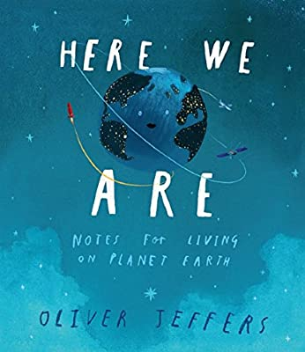
11. Here We Are

Slide 35
Here We Are
Why I choose this book: This book offers numerous discussion points throughout the book centered around empathy, kindness, and social responsibility. Gets the students thinking about our beautiful planet from various perspectives. Also the illustrations in this book are simply amazing.
Grade: 1-4
Pedagogical goals:
Big Idea (BC LA Curriculum)- Curiosity and wonder lead us to new discoveries about ourselves and the world around us.
Curricular Competencies (BC LA Curriculum)- Use personal experience and knowledge to connect to stories and other texts to make meaning.

Slide 36
Here We Are- CONT.
Strategies:
Pre-reading: select a purpose for the reading, go over the front cover- the visuals.
During-reading: determine important ideas throughout the book, go over the illustrations, infer meaning within the text
Post-reading: determine the main point, clarify understanding, have students do a worksheet about what “their wonderful world looks like”.

Slide 37
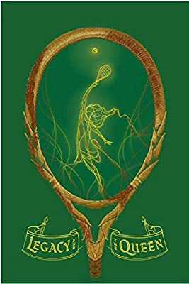
12. Legacy and the Queen

Slide 38
Legacy and the Queen
Why I choose this book: This books empowers individuals to go after your dreams no matter what circumstances you are in. A young lady is eager to pursue her dream of becoming a pro tennis player however she lives in an orphanage and can’t afford to go to school but she doesn’t give up and overcomes obstacles that are in her way.
Grade: 5-7
Pedagogical goals:
Curricular Competencies (BC LA Curriculum)- Recognize and appreciate how different features, forms, and genres of texts reflect different purposes, audiences and messages.
Curricular Competencies (BC LA Curriculum)- Construct meaningful personal connections between self, text, and the world.

Slide 39
Legacy and the Queen- CONT.
Strategies:
Pre-reading: Select a purpose for the reading, preview the title, the cover, and the organizational features in the book.
During & Post Reading: This chapter book will be read over many weeks. Have the students do a creative writing project- short story of their own.

Slide 40
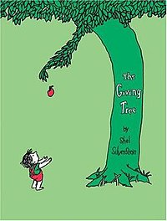
13. The Giving Tree

Slide 41
The Giving Tree
Why I choose this book: This book shows a friendship that a boy has with a tree from a very young age to a very old age and sticks with him at every stage of his life. The story talks about the connection the little boy has with the tree and how the tree is always there to play with him, listen to him and just there to be his friend.
Grade: 1-4
Pedagogical goals:
Big Idea (BC LA Curriculum)- Language and story can be a source of creativity and joy.
Big Idea (BC LA Curriculum)- Everyone has a unique story to share

Slide 42
The Giving Tree- CONT.
Strategies:
Pre-reading: select a purpose of the read, go over the title and the cover, ask students what they think the story will be about.
During-reading: Make connections, determine important ideas, infer meaning with the text.
After-reading: respond through talking, writing and drawing- have students draw what their tree would look like and then write down words that help describe the way you feel about your tree.

Slide 43
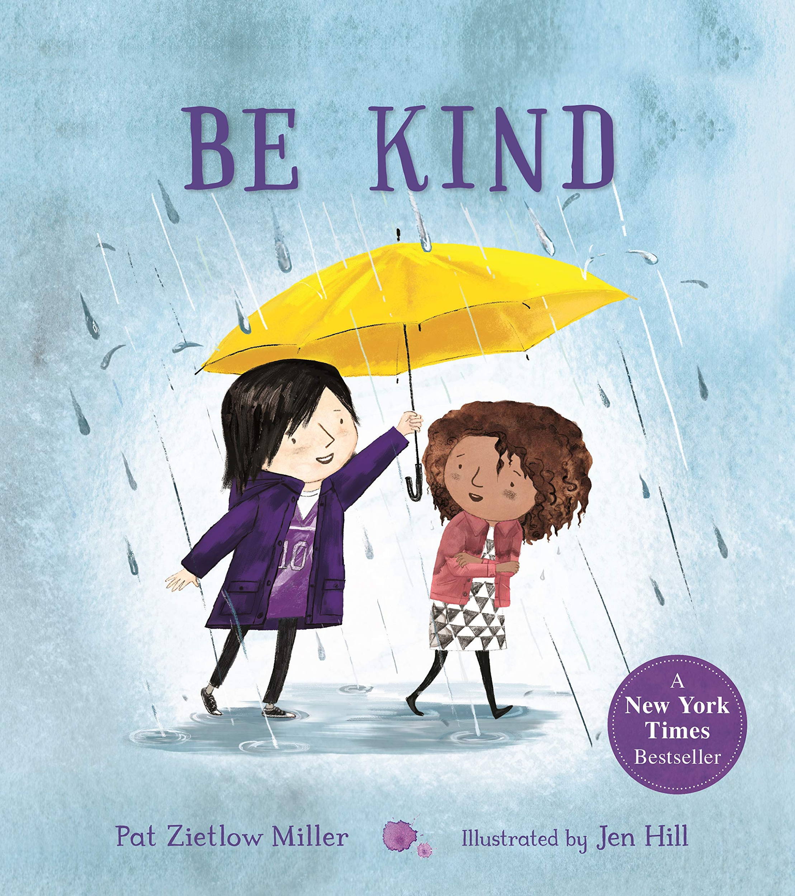
14. Be Kind

Slide 44
Be Kind
Why I choose this book: This book shows examples of ways that we can show kindness to others. It shows how a small act of kindness can feel very big to the person receiving it. This book can teach students the value of being kind and how we can show kindness in the classroom.
Grade: 1-5
Pedagogical goals:
Curricular Competencies (BC LA Curriculum)- Explain the role that story plays in personal, family, and community identity
Curricular Competencies (BC LA Curriculum)- Use personal experience and knowledge to connect to text and make meaning.

Slide 45
Be Kind- CONT.
Strategies:
Pre-reading: Select a purpose of the reading, go over the front cover- ask meaningful questions, have students start thinking
During-reading: Make connections within the story, determine important ideas, infer meaning
Post-reading: Analyze and evaluate ideas, information and perspectives, have students come up with things they can do on a daily basis to help others out- brainstorm.

Slide 46
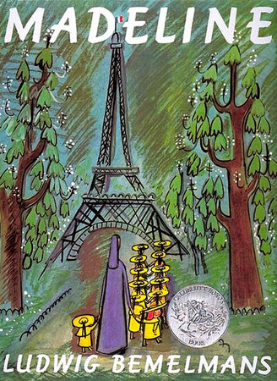
15. Madeline

Slide 47
Madeline
Why I choose this book: This book brings up the message that you can do anything that helps you grow as a person no matter how you look or how you talk. Madeline is an empowering girl who is brave enough to stand up to her classmates and show them whatever they can do she can do.
Grade: 3-5
Pedagogical goals:
Big Idea (BC LA Curriculum)- Exploring stories and other texts helps us understand ourselves and make connections to others and to the world.
Curricular Competencies (BC LA Curriculum)- use personal experience and knowledge to connect to text and deepen understanding of self, community, and the world.

Slide 48
Madeline- CONT.
Strategies:
Pre-reading: select a purpose for the reading, go over the title, the front cover and some history about schools in England.
During-reading: determine important ideas, monitor understanding, infer meaning within the text
Post-reading: clarify understanding, summarize, synthesize and draw conclusions.

Slide 49
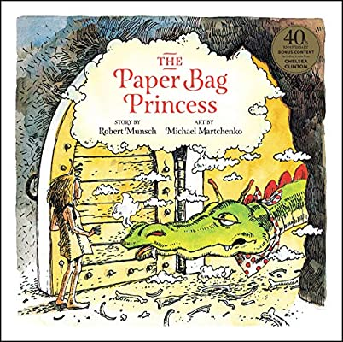
16. The Paper Bag Princess

Slide 50
The Paper Bag Princess
Why I choose this book: This book talks about how not to “judge a book by its cover”, meaning never judge someone on their appearance or their living situation or anything in that matter. This book explains how a young girl outsmarted a dragon, while the dragon didn’t think she could based on what she was wearing.
Grade: 1-5
Pedagogical goals:
Curricular Competencies (BC LA Curriculum)- Explain the role that story plays in personal, family, and community identity.
Curricular Competencies (BC LA Curriculum)- Use developmentally appropriate reading, listening, and viewing strategies to make meaning

Slide 51
The Paper Bag Princess- CONT.
Strategies:
Pre-reading: Select a purpose for the read, go over the cover- the visuals, title and make predictions about what they think the book is going to be about.
During-reading: Go over text- make connections with it, determine important ideas, use context clues to understand vocab, infer meaning.
Post-reading: clarify understanding, analyze and evaluate ideas, information and perspectives.

Slide 52
17. The Berenstain Bears Go to School

Slide 53
The Berenstain Bears go to School
Why I choose this book: When I was growing up I loved this series, they were fun and enjoyable books but also taught a valuable lesson as well. Every book was them learning something, or doing something that was wrong or just general life lessons.
Grade: K-4
Pedagogical goals:
Big Idea (BC LA Curriculum)- Stories and other texts can be shared through pictures and words.
Curricular Competencies (BC LA Curriculum)- Use personal experience and knowledge to connect to stories and other texts to make meaning.

Slide 54
The Berenstain Bears go to School- CONT.
Strategies:
Pre-reading: Go over the title/ cover and start a discussion about their first day at school.
During-reading: visualize the text/picture, determine important ideas, monitor understanding.
Post-reading: clarify understanding, respond through talking, writing, drawing- have students draw pictures about their favorite part of their first day of school!

Slide 55
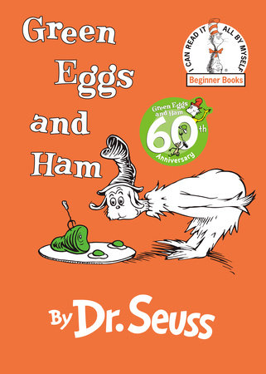
18. Green Eggs and Ham

Slide 56
Green Eggs and Ham
Why I choose this book: I really adore the Dr.Seuss books, when I was younger that was another series I use to read. I think their enjoyable books for kids to read and most of them usually have a message that kids can learn from. This book was probably one of my favorites from the series, would love to read this one day to my class.
Grade: K-4
Pedagogical goals:
Curricular Competencies (BC LA Curriculum)- Recognize the structure and elements of story
Curricular Competencies (BC LA Curriculum)- Use developmentally appropriate reading, listening and viewing strategies to make meaning.

Slide 57
Green Eggs and Ham- CONT.
Strategies:
Pre-reading: Go over the cover, examine the title, make assumptions of the book/ predict
During-reading: determine important ideas, monitor understanding, go over the visuals.
Post-reading: Clarify understanding, extend understanding in critical and creative ways- art project

Slide 58
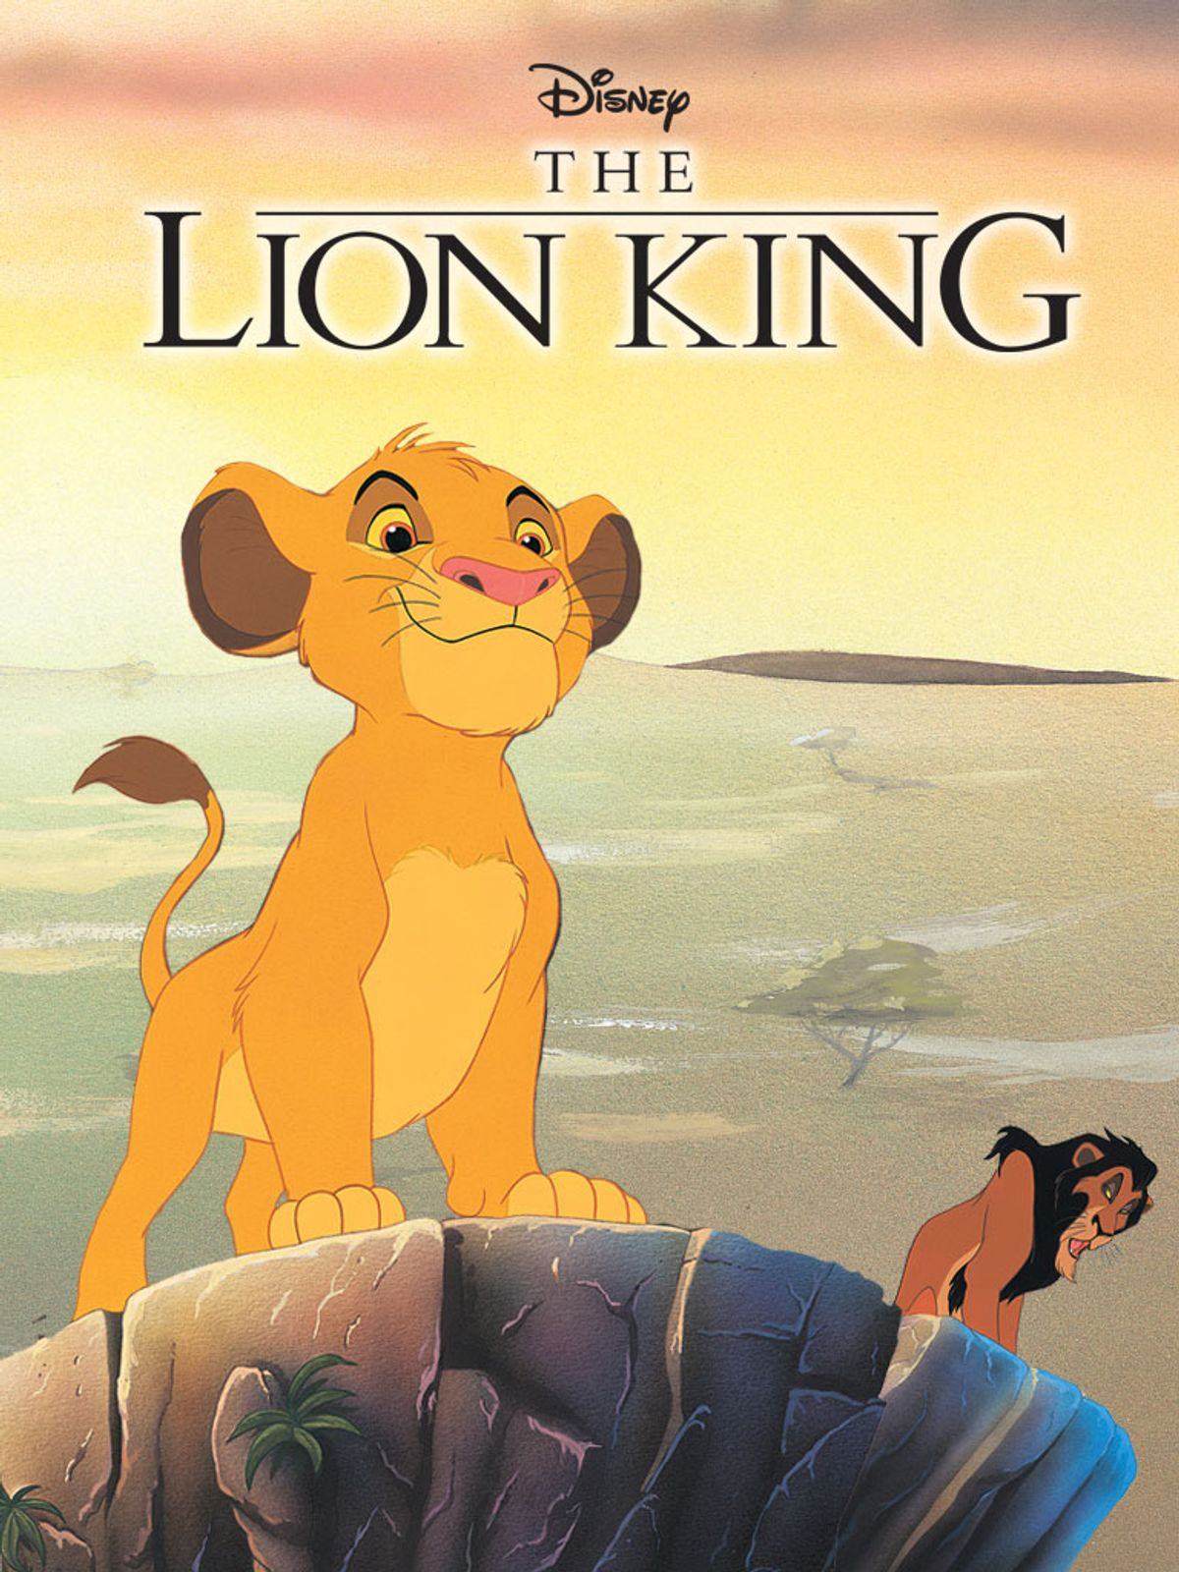
19. The Lion King

Slide 59
The Lion King
Why I choose this book: I really loved the disney books growing up, it was such a fun way of telling a story or sending a message to the kids. In the lion king the story is about betrayal within family and to always protect your family. I think that is such an important topic to talk about.
Grade: K-4
Pedagogical goals:
Curricular Competencies (BC LA Curriculum)- Apply a variety of thinking skills to gain meaning from texts
Curricular Competencies (BC LA Curriculum)- Use personal experience and knowledge to connect to text and deepen understanding of self,community, and the world

Slide 60
The Lion King- CONT.
Strategies:
Pre-reading: select a purpose of the read, preview the front page- title and visuals, activate prior knowledge-maybe the students are already familiar with the book.
During-reading: Determine important ideas, monitor understanding, infer meaning.
Post-reading: clarify understanding, summarize main points, extend understanding in critical and creative ways- do an activity after the read.

Slide 61
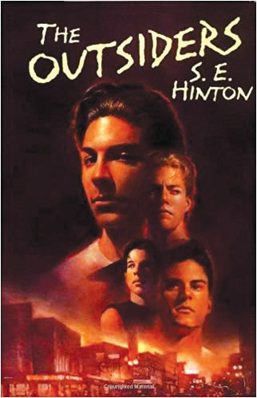
20. The Outsiders

Slide 62
The Outsiders
Why I choose this book: I read this book in grade 7 and I think this was the only book I really enjoyed throughout my 4-7 grade experience. Most of the books the teachers gave us were dry and boring. I think this book sends a good message about how society still is especially at that age level where the students are changing and getting ready to go to highschool.
Grade: 7
Pedagogical goals:
Big Idea (BC LA Curriculum)- Questioning what we hear, read, and view contributes to our ability to be educated and engaged citizens.
Curricular Competencies (BC LA Curriculum)- Think critically, creatively, and reflectively to explore ideas within, between, and beyond texts.

Slide 63
The Outsiders- CONT.
Strategies:
Pre-reading: Select a purpose for the reading, activate prior knowledge within the topic, question and discuss the message behind the book.
During & Post Reading: This chapter book will be read over many weeks. Have the students do a project on the book- a fun book report or visual presentation.

